Slide 1
Error Handlers

Slide 2
Team Members
Tina Soni
Mohammed Rauf
Yasra Fatema

Slide 3
Objective
The objective of the project is to create an interactive and customer friendly application which will attract the customer and to generate more revenue.
The basic goal is to create a B2C application comprising of prepaid data plans for mobile and fibre recharge wherein the employees can maintain records of the products purchased by the customers. We used basic salesforce credentials to meet this requirement.

Slide 4
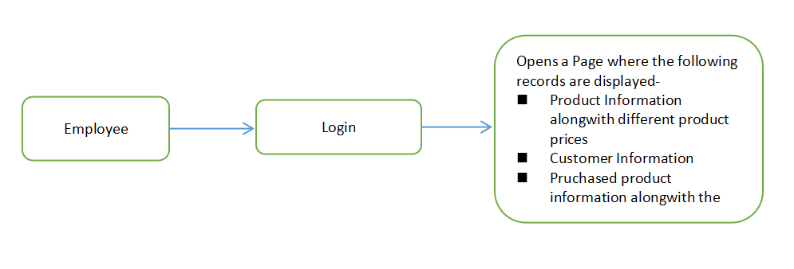

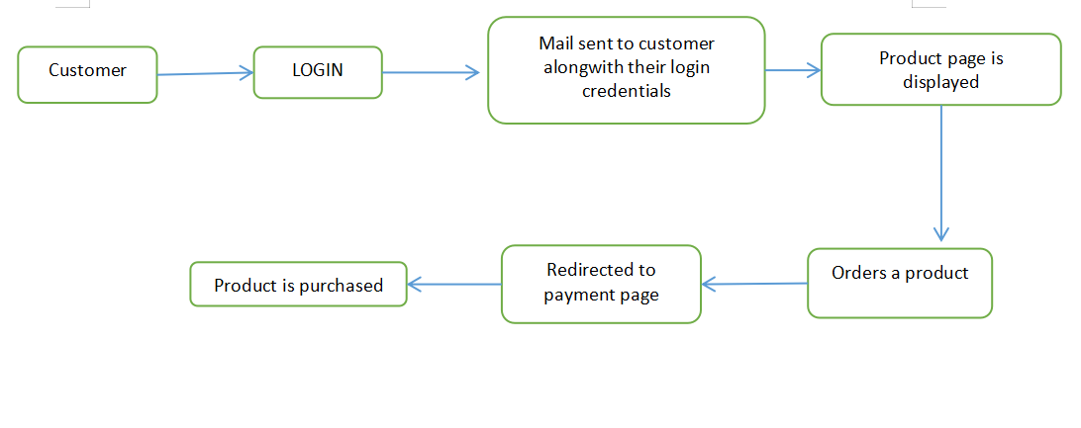
Scope
Customer Flow
Employee Flow

Slide 5
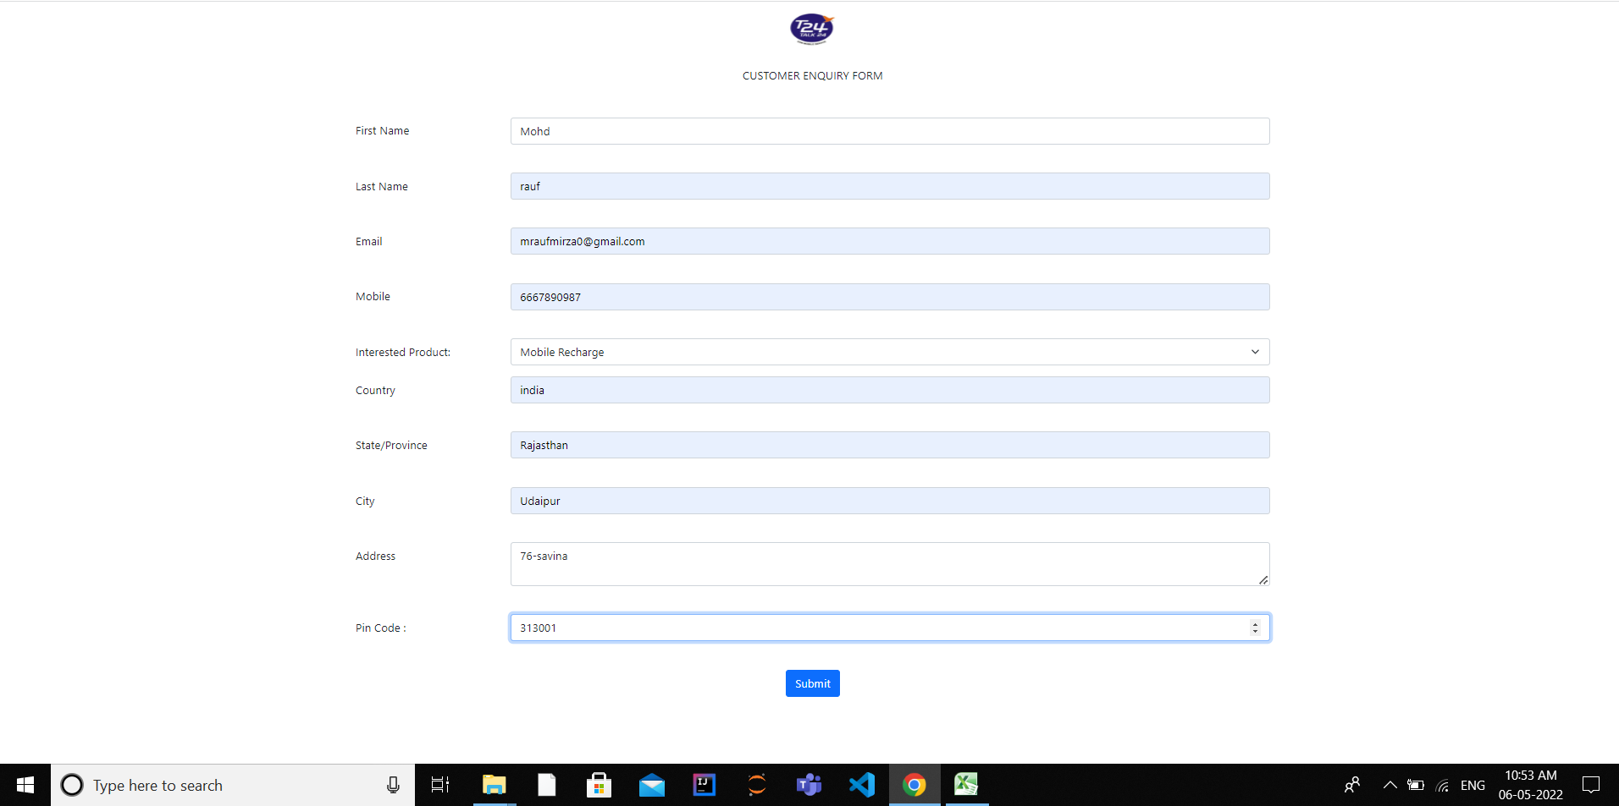
Customer Enquiry form
From customer enquiry form the customer can fill all the information and can choose their interested product. This information will be sent to the employee for further process.

Slide 6
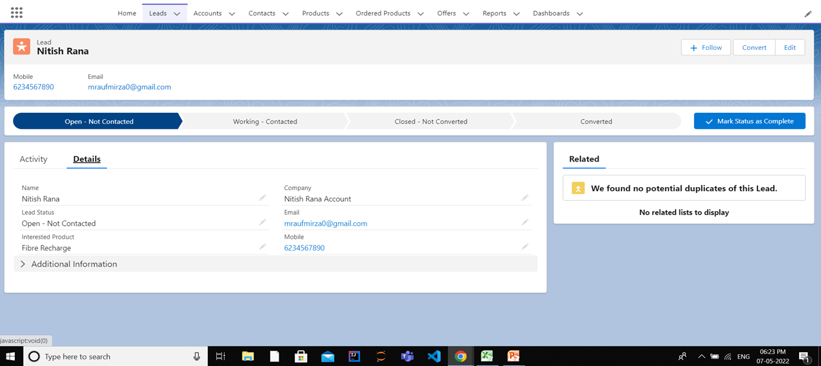
Customer Detail
All the details of the customer and their interest will be sent to the employee and will be stored in Lead. Employee will verify the customer’s detail and convert the lead.

Slide 7
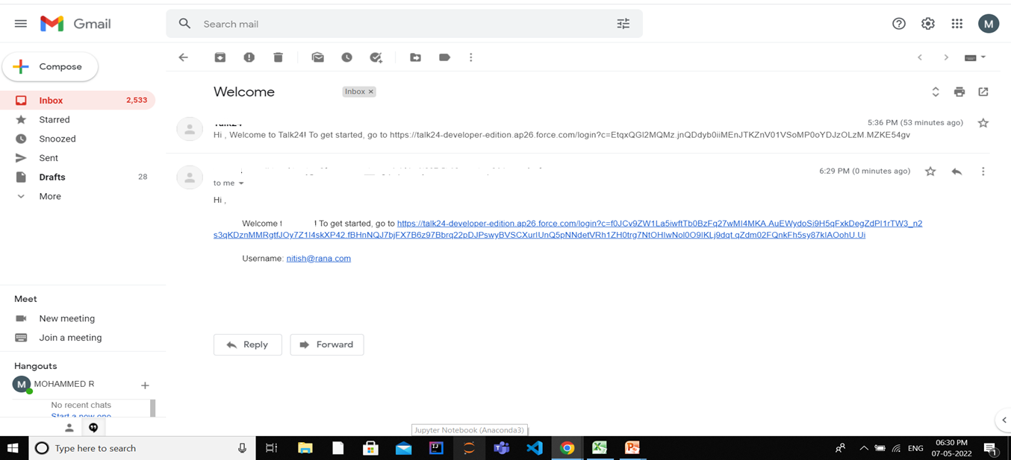
Customer Id Password
On conversion of lead customer will receive an email with customer id and a link through which they can reset their password. Using that id and password customer will be able to login to the customer site.

Slide 8
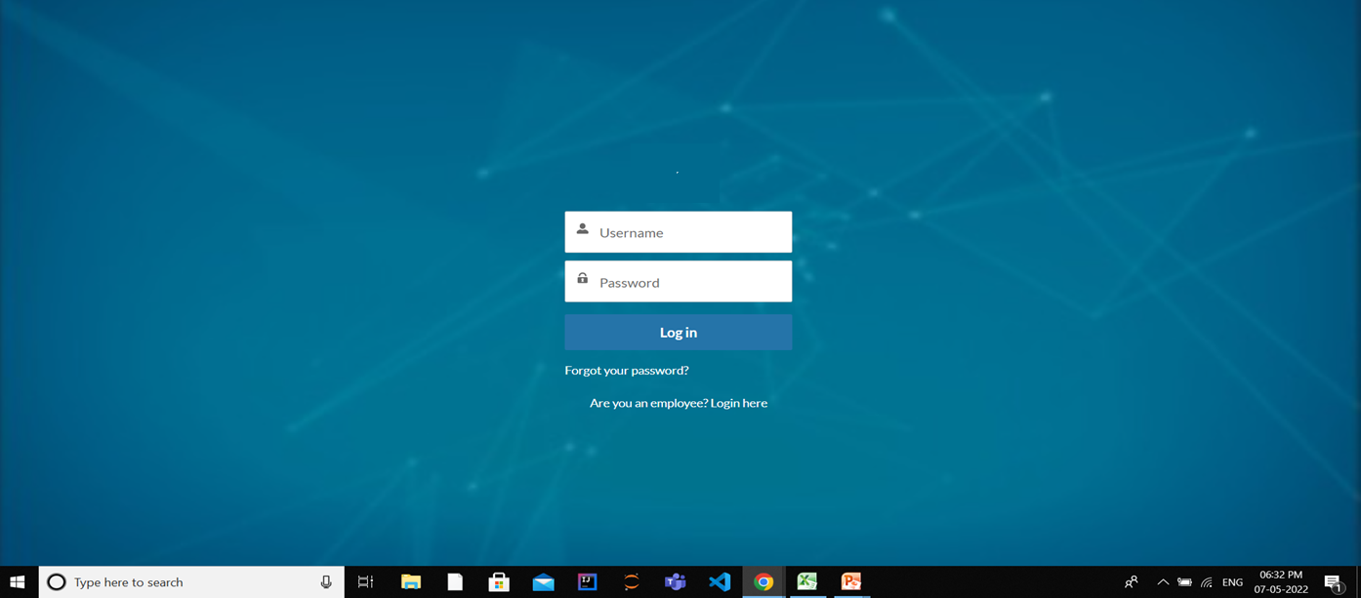
Customer Login Page
Customer can login to the customer site from this page using correct user id and password.

Slide 9
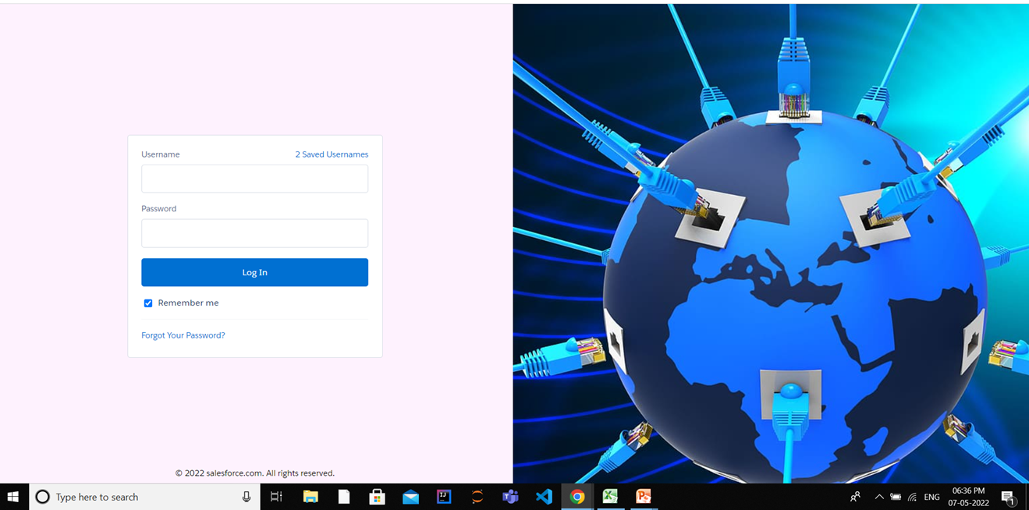
Employee/Admin Login Page
Employee can login to the Employee site from this page using correct user id and password.

Slide 10
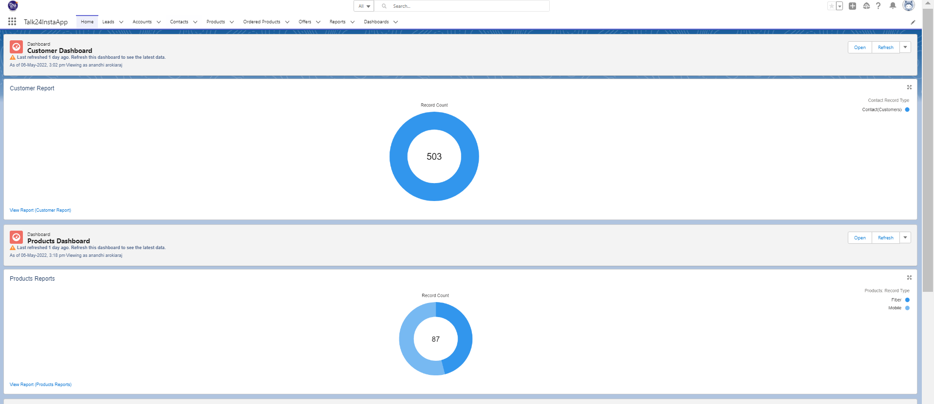
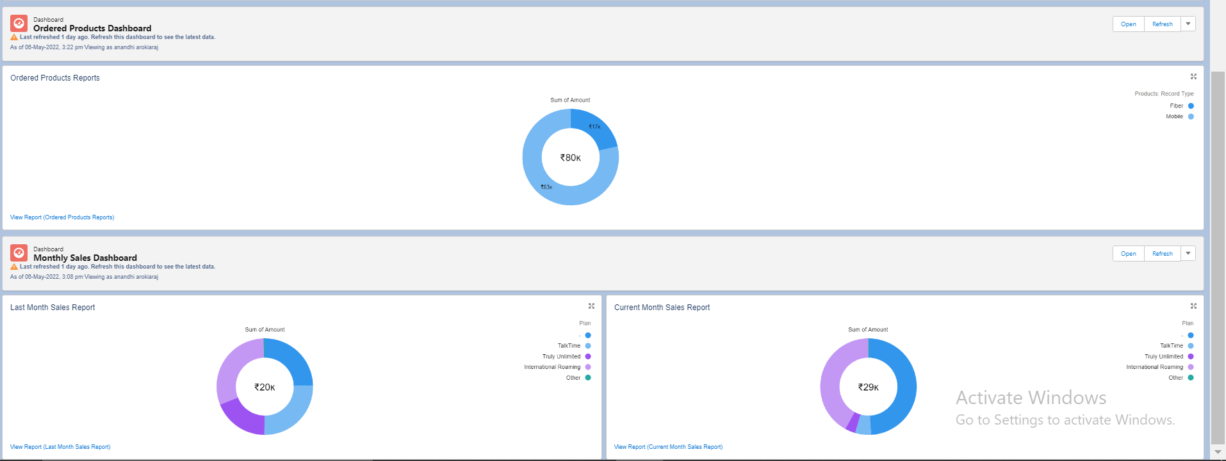
Reports and Dashboards
Customer and Product Dashboard
Ordered product and monthly sales Dashboard

Slide 11
Thank You

